Slide 1
B2B
Name:
Course Name:
Course Code:
School:
Professor:
Date:

Slide 2
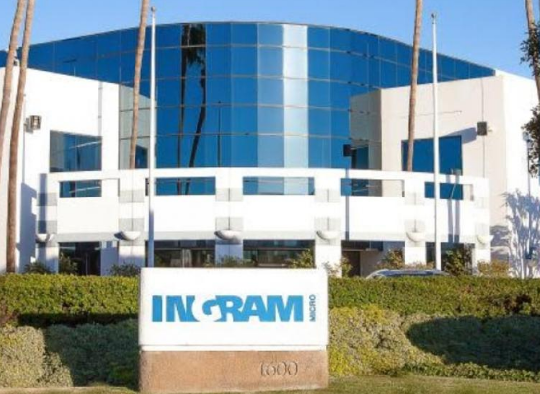
Introduction
Ingram Micro is a Chinese-owned company, which deals with information technology products such as television sets. The company headquarters are situated in California.

Slide 3
2 by 2 SWOT Analysis
Strengths
Technological capabilities to meet its objectives as well of the customer needs (Business)
Strong employee base
Improved profitability
Market competitiveness
Weakness
Financial challenges
Overdependence on third party services
Ingram Micro has many lawsuits and pending actions against the company
Opportunity
Connectivity and integration
Integration to a merchant ERP
Reverse logistics
Growth in strategic acquisition, distribution channels, and service to its customers
Threats
1. Intense competition from its rivals

Slide 4
Assessment and Analysis
The company uses competitive marketing strategies that enhance its business to thrive in the market of consumer electronics. The target market that Ingram looks at is the electronic consumer market.
The first stage
Ingram Micro uses the Enterprise resource Planning (ERP).
It uses integrated systems The system also gives the company the power to manage other activities involved such as marketing and advertising
The second stage
Ingram uses is the transport management system (TMS) to enhance delivery.
The third stage
Warehouse management system (WMS) offers time solutions for managing inventories.
The forth level
Personalized delivery of the product to the customer.

Slide 5
References
B2B Marketing Magazine. (n.d.). United Kingdom: Silver Bullet Publishing Limited.
Creative Educational Video, Inc., & Insight Media (Firm). (2016). SWOT analysis. Lubbock, Tex.: CEV Multimedia.
Datamonitor (Firm). (2011). Ingram Micro Inc. New York, NY: Datamonitor.
Friedman, M. (2011). Understanding B2B. Chicago, IL: Dearborn Trade.
Harwood, S. (2013). ERP: The implementation cycle. Oxford (UK: Butterworth-Heinemann.
Hutt, M. D., & Speh, T. W. (2013). Business marketing management: B2B. Australia: South- Western, Cengage Learning.
Mannings, R. (2012). Ubiquitous positioning. Boston: Artech House.

